Slide 1
Azure Backup & Recovery
OCC Engineering team
Srichand Jakka

Slide 2
Agenda
1
Azure Backup
2
Backup consistency levels
3
VM Recovery
4
Azure Site Recovery Overview
5
Q&A

Slide 3
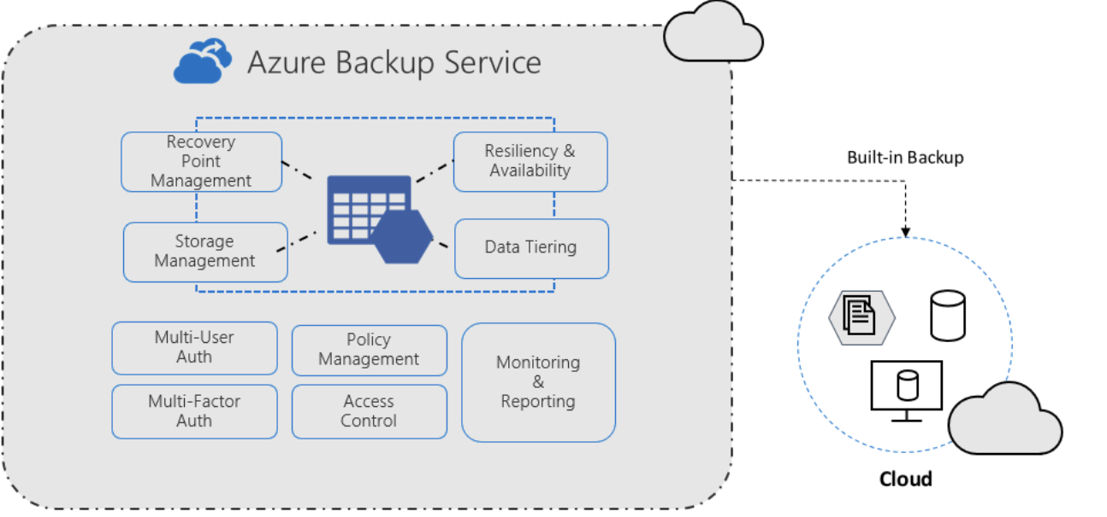
Azure Backup
Full managed service for backing up and recovering workloads
Zerto Infrastructure backup
High Availability
Centralized monitoring and management

Slide 4
Supported Workloads
On-premises
VMs
SAP HANA
SQL Server in Azure VMs
Azure VMs

Slide 5


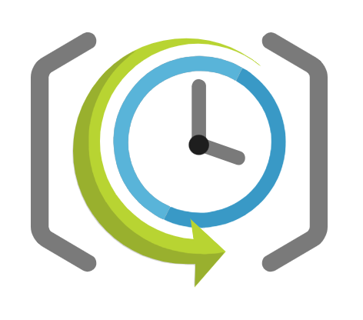
Azure Backup Components
Recovery Services vault
Backup Policy
Backup Job
Management entity to stores recovery points that are created over time
Provides an interface to perform backup-related operations
Define the backup frequency and retention duration the backups
Backup extension
Initial backup starts according to backup policy configured
%
treatment plans improved
Supported Workloads

Slide 6



VM Backup Consistency Levels
Application consistent
File system consistent
Crash consistent
Preferred backup type
Data is consistent with the time of backup (VSS)
Ensures the VM boots up
No data corruption
Least preferred backup type
Used when the VM is shutdown

Slide 7



VM Recovery Options
Entire Virtual Machine
Disks
Files & Folders
OS and data disks configuration
Restore to original location or create a new vm
Restores a VM disk
Help to customize the VM if required
Recover individual files from recovery point
Mount the Snapshot on the target machine

Slide 8




Disaster Recovery
Disaster Recovery
Recovery Point Objective (RPO)
Recovery Point Objective (RPO)
Process of recovering from a disaster
Requires a business continuity and disaster recovery (BCDR) plan
Defined maximum amount of data the organization can tolerate losing
Maximum window of time allowable for the restoration process

Slide 9
Azure Site Recovery
Ensure business continuity by keeping business apps and workloads running during outages
Requires a Recovery Services Vault
Simplified BCDR solution
Customized recovery plans
Testing without production disruption
Orchestrates replication
Protects on-premises VMs and physical servers
Protects Azure VMs between Azure regions

Slide 10
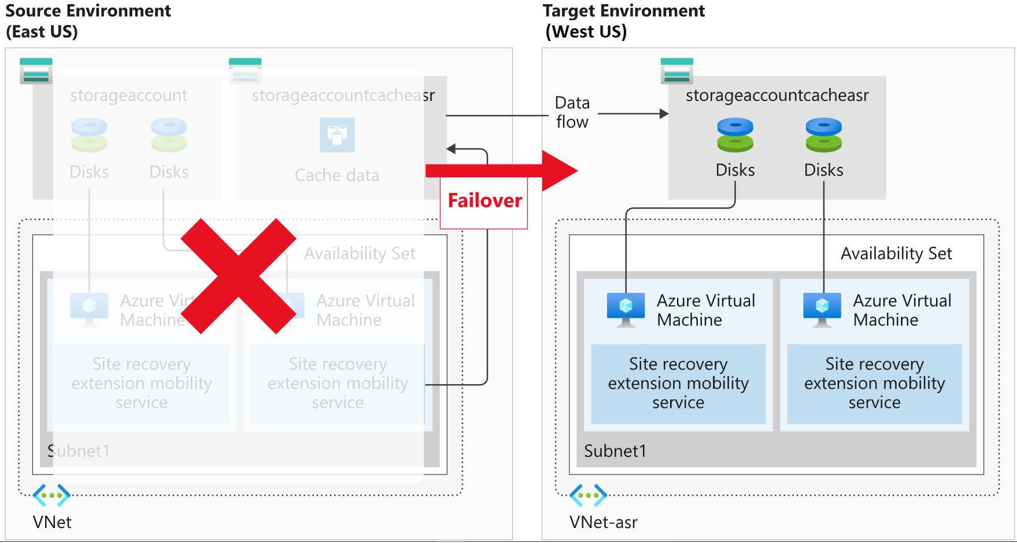
Azure Region - Region

Slide 11
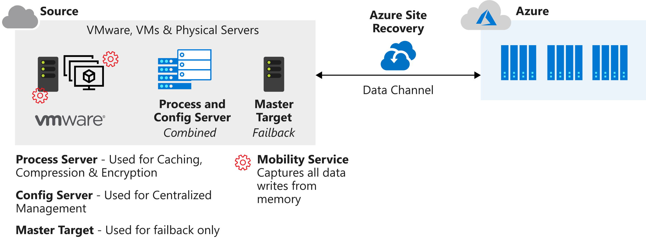
On-Prem VMware - Azure

Slide 12
DR Drill
To ensure the BCDR solution implemented meets the business requirement
Replication works as expected
Can be once or twice in a calendar year
Test Failover
Select recovery point
Create VM
App Validation
Rollback

Slide 13
DEMO

Slide 14
Q&A

